Slide 1

Module Nine: Civil Transgressions in a Digital Medium
CIS 303 – Prof. C. R. Johnson

Slide 2
BEHOLD! THE FUTURE IS NOW!
https://www.youtube.com/watch?v=gElfIo6uw4g

Slide 3
Bideo gaems
Video games are a huge industry. (~$180 B)
The days of the console are likely fading, but PC and Mobile are huge growth platforms since COVID lockdowns.
Movies are still the most popular in terms of longevity and gross return, it isn’t even close.
https://vgsales.fandom.com/wiki/List_of_highest-grossing_video_games
https://en.wikipedia.org/wiki/List_of_highest-grossing_films

Slide 4
But not all games are equal
While games had to work hard to be taken seriously as an art form, at the end of the day we have to admit that some… just aren’t. But neither are all movies, books, or paintings.
Some games offer more interactivity.
Some games offer more customizability.
Some games offer more immersion.
These factors don’t guarantee “art” but they do offer a more personal experience.

Slide 5
We play games for different reasons
Intrinsic motivation – Challenge, skill investment, entertainment.
Wishful Identification – Escapism, fantasy, maybe IRL desires.
Competence – People like to feel successful, and we like to feel like we’re growing and progressing in our knowledge and accomplishments.
Autonomy - The desire to feel independent or have a certain amount of control over our actions.
Relatedness - We like to feel like we matter to others, and we like to feel like we are making a significant contribution to society.

Slide 6
The Proteus effect
A phenomenon known as the Proteus effect describes what happens when the behavior of an individual is influenced by the characteristics of their avatar. The roles that players adopt when immersing themselves in a video game — and the accompanying characters, story, and virtual environment — allow them temporary glances into different perspectives or different life experiences than their own. Having interactions with other characters in a game while playing as a virtual avatar, for instance, can grant players the opportunity to take the identity of someone else and act differently than how they normally would.

Slide 7
Proteus Effect - Origins
We infer others’ appearance and behavior to make inferences about their personality. - their persona. Would you be surprised to learn we do that with ourselves, too?
This research has its roots in what’s called self-perception theory, a watershed concept in social psychology pioneered by physicist-turned-psychologist Daryl Bem in the 1960s. Essentially, the theory says that we observe ourselves and use that information to make inferences about our attitudes or moods.
Notes:
For example, someone who hurls themselves out of an airplane with a parachute might think, “I’m skydiving, so I’m the kind of person who seeks out thrills.”
In one clever study of this theory by Fritz Strack and his colleagues³, subjects were given a ballpoint pen and told to hold it in their mouth in one of two ways. Some were asked to use pursed lips and others were told to hold it between their front teeth, with their lips drawn up and back. The former approach tricked the subjects into frowning, while the latter got them to smile. When asked to rate the amusement value of a cartoon, those who were being made to smile thought it was far funnier than those who were forced to frown. Their appearance was affecting their mood.

Slide 8
The Proteus effect on us
How do virtual avatars affect our behavior? In one study participants were given an avatar they could not see at all times. They were told to inspect themselves in the virtual mirror, then approach the room’s other occupant and chat with him or her. This other person was controlled by a research assistant and followed a simple script to get the conversation going, saying something like: “Tell me a bit about yourself.”

Slide 9
The Proteus effect on us
People tended to conform to the expectations of their appearance.
The study revealed that an avatar’s attractiveness affected how its owner behaved. Relative to those with ugly avatars, people assigned attractive looks both stood closer to the other person and disclosed more personal details about themselves to this stranger. People using taller avatars were more assertive and confident when they engaged in a simple negotiation exercise.

Slide 10
The Proteus effect
We’re more likely to vicariously learn more from people or media characters that we identify with.
Games that allow more customization allows greater identification.
In an interactive exercise game in which players’ physical movements were tracked and matched to their avatar, participants increased their physical activity when their character was thinner and decreased their physical activity when the character was obese.

Slide 11
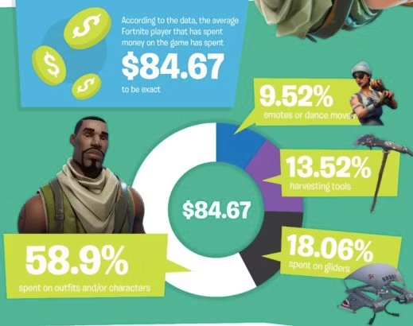
The Proteus effect
“Studies have shown that, in general, people create slightly idealized avatars based on their actual selves, but a compensation effect has been observed. People with a higher body mass index – likely overweight or obese – create more physically idealized avatars, which are taller or thinner. And people who are depressed or have low self-esteem create avatars with more idealized traits, such as being more gregarious and conscientious.” -Nick Yee

Slide 12
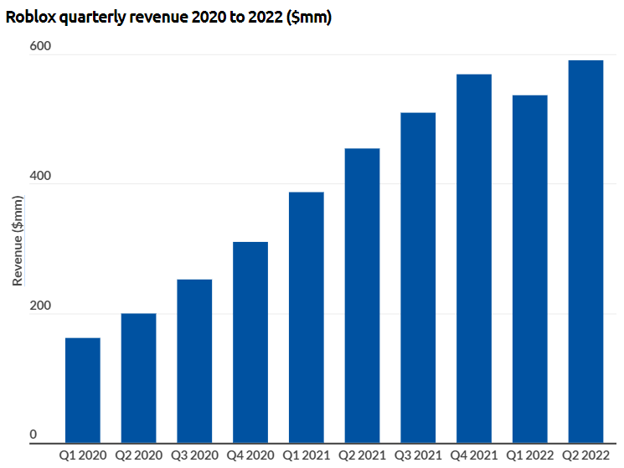
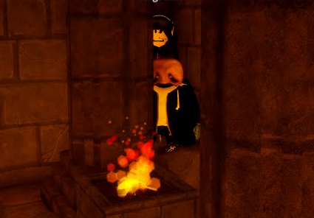

But obviously there is more to it

Slide 13
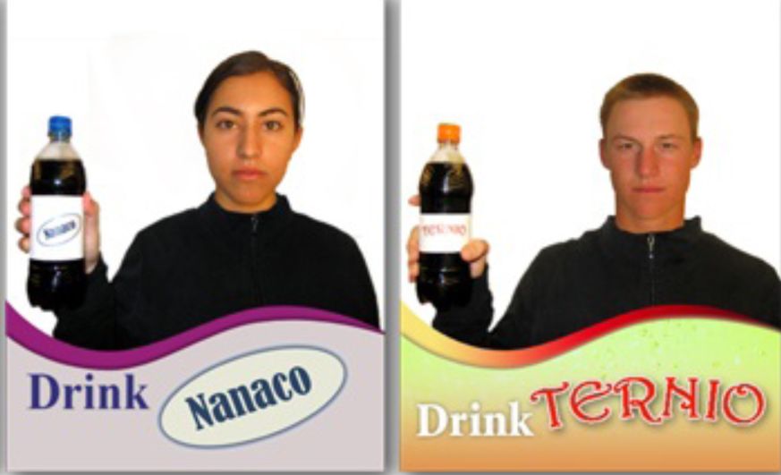
I’d buy that for a dollar
This can be used to manipulate us, though. It’s a visual self-representation that we do not control. What if…
Notes:
In their study, the team altered photos of people to show them holding up fictitious brands of fizzy drinks like “Cassina” or “Nanaco.” Even though the participants knew the photo was doctored, they tended to express a preference for the fake brand, simply because they’d seen a representation of themselves holding it.
It’s not all scary news, though. For example, psychiatrists use mental visualization as a technique for treating phobias and social disorders. Someone deathly afraid of swimming, for instance, might be coaxed into imagining themselves at a pool. Through this kind of repeated imaginary exposure, the person might eventually seize control of their phobia.

Slide 14
Factors that drive immersion
(1) virtual exploration,taking advantage of the digital, immersive environments to do things otherwise impossible or difficult;
(2) social navigation, maneuvering the social dynamic in these complex worlds to make friends and build reputation;
(3) contextual adaptation, adjusting and responding to the socio-cultural contexts; and
(4) identity representation, portraying either the actual or the ideal self.

Slide 15
The Milgram Obedience experiment
The Milgram Experiment – 65% conformity in the original.
Dropped to 20% if the experimenter had no symbol of authority.
Dropped to 47.5% if done in run-down offices instead of Yale.
Dropped to 30% if the teacher had to physically touch the learner.
Dropped to 10% in the presence of disobedient participants.
Dropped to 20.5% without authority observation.
Jumped to 92.5% when ordered to order someone else to push the button.

Slide 16
The Milgram Obedience experiment
So obviously, abstraction from consequence means immoral action.
Nope.
Similar experiments on virtual scenarios: The Peña Experiment.
Participants played as superheroes or supervillains. Created by the players to be a version of themselves.
Instructed by the game to administer shocks to an NPC.
Heroes were less likely to shock, and more likely to feel guilty about it. They felt it was their duty to not follow the instructions of the authority.

Slide 17
The proteus effect on us
Games can influence behavior, but not in the way most moral panic purveyors reckon.
Games do not cause dark tetrad traits to manifest. They do provide an outlet for them.
Games do seem to cause some influence over cognition – hence, they can teach.
This is the essential problem with “learning” or “training” games:
Low user interactivity
Low user immersion
Outcomes not associated with idealization, but with rational outcomes.

Slide 18
Rules are made to be broken
Essentially, games are not a one-way street like pure consumption media.
Developers create the world, control the rules.
Players make the game. Some players game the game.

Slide 19
Game economies
Taps – Inlets where game resources come out.
Drains – Outlets where game resources go.
Pinches – Controls that determine the flow of game resources.
Converters – Mechanics that transform one resource into another.
Traders – Mechanics that transform resources, but do not destroy them in the process.

Slide 20
Case Studies in Gamification
America’s Army – A simulator/FPS that the Army produced for propaganda / recruiting purposes.
World of Warcraft – Digital plague.
Various cybersecurity training games.

Slide 21
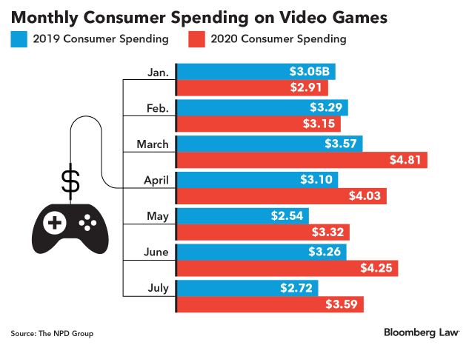
Virtual Items, real dollars
Monetizing in-game economies is crucial for studio revenues, but it’s been a very bumpy road.
Arbitration is often used to dissuade lawsuits, but the list of lawsuits for in-game currency and loot boxes is growing.
Google and Apple recently filed motions to dismiss suits against them. They argue partly that because they don’t create any games, they’re protected by the federal Communications Decency Act.

Slide 22
Virtual theft and fraud
https://arstechnica.com/gaming/2008/10/dutch-court-imposes-real-world-punishment-for-virtual-theft/
This is especially an issue when it comes to user-created content, such as the lawsuit Roblox dealt with not long ago.
Furthermore, who actually owns those items is up for debate.

Slide 23
Jurisdiction for lawsuits
The prevailing rules of the day is known as a “minimum contacts” standard.
An interactive or active website is one where business transactions can occur through the website or information can be exchanged to solicit business.
A passive website is one that is used to post information for potential customers, but it does not allow for interaction.
Aka. The Zippo Sliding Scale (1997)

Slide 24
The Zippo Scale
Zippo Manufacturing Company, a Pennsylvania corporation, makes the well-known Zippo pocket lighters. Zippo.com was a California corporation that operated an Internet website that offered access to USENET newsgroups. The Zippo.com company registered the domain names "zippo.com," "zippo.net" and "zipponews.com," without regard for the prior use of that name by the lighter company.
Zippo Manufacturing filed a complaint in its own Pennsylvania district court against Zippo.com, alleging trademark dilution, trademark infringement, and false designation under the Lanham Act and state law trademark dilution statutes.
Notes:
Why it’s important: The web is "world wide," right? So which courts get to decide if a certain website has violated the law? This case paved the way toward establishing standards in that regard under the legal concept of "personal jurisdiction." What the case is about: Zippo Manufacturing, the well-known Pennsylvania lighter company, sued Zippo Dot Com, a California web company that provided about 140,000 users with access to USENET newsgroups. The court battle involved perceived trademark violations: The lighter company wanted the web company to stop using the name Zippo. A main point in this case, the lighter company operated exclusively in Pennsylvania while the internet company only conducted about two percent of its business in Pennsylvania (where it had registered about 3,000 users). Keeping that in mind, a Pennsylvania federal district court made the distinction between a "passive" website and an "interactive" one. Because the internet company conducted an interactive business — via forums, etc. — with the 3,000 or so Pennsylvania users, that was enough to establish personal jurisdiction and force the internet company to relinquish the Zippo name in Pennsylvania. Zippo Dot Com (the USENET company, not the lighter manufacturer) went out of business not long before the case ended but the decision established the Zippo Test, which asked courts to consider whether a site was "passive," "interactive," or "commercial" as a way to decide whether or not it should be held liable under a certain state’s laws. Yes, the Zippo Test has evolved — and there are similar personal jurisdiction cases that are worth knowing about and that call the Zippo Test into question for being too simplistic — but the Zippo case had a huge impact on the internet for a long time. Goldman: "Even if the rule of law is now weakened, [the Zippo case] highly influenced Internet jurisdiction law for over a decade, and it is still cited more than perhaps any other Internet Law case."

Slide 25
The Zippo Scale
The court established a three-prong test for determining whether a court has jurisdiction over a website, with a sliding scale of minimum contacts in a territory outside that of the site's origin. Under the sliding scale, "the likelihood that personal jurisdiction can be constitutionally exercised is directly proportionate to the nature and quality of the commercial activity that an entity conducts over the Internet."

Slide 26
The Zippo Scale
In Rannoch, Inc v. Rannoch Corporation, 52 F. Supp. 2d 681 (E.D. Va. 1999), even an interactive Web Site accessible in Virginia was an insufficient basis upon which to base personal jurisdiction where there was no evidence that the Internet activities were directed at Virginia and no evidence of actual use of the Web Site by Virginia residents.
By contrast, in Inset Systems, Inc. v. Instructions Set, Inc., 937 F. Supp. 161 (D. Conn. 1996), the only activity that the Web Site operator engaged in besides maintaining its Internet Site was providing a toll-free number on the Site. Although seemingly innocuous, the court perceived the toll-free number as an attempt to solicit business in the forum state and extended personal jurisdiction over the defendant.

Slide 27
Zeran v. AOL - 1998
This case allowed website owners to host third-party content without having to worry about being prosecuted if someone published something illegal on that website.
It is why sites like YouTube do not need to legally clear material before publishing it on their site.
Notes:
About a week after the Oklahoma City bombings in April 1995, posts appeared on an AOL messageboard offering items for sale that were printed with multiple exclamation point witticisms such as, "Visit Oklahoma ... It’s a BLAST!!!" and "McVeigh for President 1996." The posts directed users to contact Seattle resident Kenneth M. Zeran and listed the guy’s home phone number. The posts were a bizarre prank — Zeran claimed not to know anything about the messageboard or the items ostensibly for sale — but the phenomenon went viral after an Oklahoma City radio DJ encouraged his listeners to express their outrage in Zeran’s direction. For a while, Zeran received hundreds of angry phone calls per day and eventually required protective assistance from the FBI at his home. He sued the radio station’s owners for amplifying the prank and AOL for publishing the prank in the first place. The radio station suit was interesting enough but the suit against AOL was monumental; it had the potential to change everything about the web. Like Reno, it called into question an element of the then- brand-new Communications Decency Act. But this time it wasn’t the indecency provision, it was the law’s controversial Section 230, which held that, "No provider or user of an interactive computer service shall be treated as the publisher or speaker of any information provided by another information content provider." A ruling in Zeran’s favor would have called Section 230 into question and likely required every website to vet every piece of content it published. Goldman: "It's no exaggeration to say that the Zeran case is responsible for our entire UGC economy." Hermes: "Think about YouTube. If [Zeran] had gone the other way, Google today would need to hire people with sophisticated legal backgrounds to review every single piece of content on that site. There would not be enough hours in the day. You would need to have literally millions of lawyers whose only responsibility would be reviewing user videos."

Slide 28
PROCD V. ZEIDENBERG - 1996
If you clicked to agree, it’s official: You agreed. This case confirms it.
This case has been criticized as much as it has been followed by subsequent courts, but it was highly influential in establishing the idea that all the countless ‘click-to-agree’ agreements that we now experience online are just as enforceable as any other contract.
Notes:
Grad. student Matthew Zeidenberg purchased a CD-ROM telephone directory, SelectPhone. He loaded it onto his hard drive and clicked through a series of warnings stating that the directory was licensed by ProCD and that users were not allowed to share the CD-ROM’s contents in any commercial pursuit. Zeidenberg ignored the warnings and posted the directory to a website, offering users access to the directory for a fee slightly lower than what ProCD charged. Telephone directories are not protected by copyright (see Feist v. Rural, which has nothing to do with the internet). And that was Zeidenberg’s argument: you can’t protect the copyright of something that can’t be copyrighted. But a United States appeals court decided that the series of warnings Zeidenberg clicked through were enforceable as a contract. Meaning that Zeidenberg was in violation of a legal agreement. Carver: ""

Slide 29
RELIGIOUS TECHNOLOGY CENTER V. NETCOM 1995
This case established that linking to another site didn’t equal stealing content from that site.
This case is important for the development of the internet because it allows pretty much free linking.
Notes:
Not a fan of the Church of Scientology, Dennis Erlich posted links to unpublished L. Ron Hubbard manuscripts on the Usenet newsgroup alt.religion.scientology, hosted by a Netcom server. Scientology held copyrights for the not exactly dead church leader’s unpublished manuscripts. The Church of Scientology sued Netcom for hosting the files, insinuating that it should have known that the files were copyrighted and that it had harmed the Church of Scientology for allowing the files to be posted.
The U.S. District Court in Northern California decided in Netcom’s favor, noting that Netcom had no reason to expect that Erlich, a random user, was publishing copyrighted material and that ruling against Netcom could seriously infringe upon First Amendment rights in the future. From the decision: "Netcom ... [plays] a vital role in the speech of their users. Requiring them to prescreen postings for possible infringement would chill their users’ speech."
Hermes: "[This case] is important for the development of the internet because it allows pretty much free linking." It also solidifies that "Scientologists and Jehovah's Witnesses set up a lot of the major copyright and First Amendment policies in this country because of their extremely litigious nature."

Slide 30
PERFECT 10, INC. V. AMAZON.COM, INC. - 2007
Ever hear of Google Image Search? Of course you have. This case is why it and other similar services are allowed to exist.
This case continues to have an impact as it is cited to support technologists that are creating information-location tools, such as search engines, against the overreach of copyright law.
Notes:
Perfect 10 was a magazine and subscription website in the vein of Hustler — airbrushed nudie pics of open-mouthed young women, basically — with less meddlesome politics to get in the way of body parts on display. Third-party websites took images from Perfect 10’s subscription site and posted them, violating the subscription site’s copyright. While those third-party sites were clearly in the wrong, Perfect 10’s lawyers also argued that search indexes used by Google and Amazon — which used some of the stolen third-party images — were also in violation. The argument crawled slowly through the court system, eventually making it to the United States Court of Appeals for the Ninth Circuit. There, it was determined that the "potential harm" from linking "to Perfect 10's market remains hypothetical" and that the search indexes were worth protecting because they provided "access to [pictorial] information on the Internet" and because "search engine technology provides an astoundingly valuable public benefit, which should not be jeopardized just because it might be used in a way that could affect somebody's sales."
Carver:

Slide 31
Brown et al v Google LLC et al
The lawsuit seeks at least $5 billion, accusing the Alphabet Inc unit of surreptitiously collecting information about what people view online and where they browse, despite their using what Google calls Incognito mode.

Slide 32
Langford Basilisks
We have a new danger in our wonderful modern world: Physical Assault through Digital Means.

Slide 33
Facts of the case
Kurt Eichenwald is a reporter. He’s made several enemies over the years across all political spectrums, but particularly the alt-right.
He’s also a prolific social media user, where he as posted numerous times about having photosensitive epilepsy.
In 2016 Eichenwald wrote an article about how Trump supporters attack journalists.
In response, Trump supporters attacked him over social media. It’s not the first time it happened. Previously a user on Twitter “Mike’s Deplorable AF” sent him the following:
CAUTION: LOOK AWAY IF YOU ARE PRONE TO PHOTOEPILEPTIC SIEZURES!!!

Slide 34
Langford Basilisks
Nothing came of that incident as Kurt was able to look away in time.
Not so lucky the second time when user “(((Ari Goldstein))) @jew_goldstein” went him the following, sending Kurt to the hospital following an epileptic seizure.
The ((())) (or, echo) is also a dogwhistle, btw.
This user was discovered to be John Rayne Rivello. He was charged with assault and twice indicted by a Texas grand jury. Both the civil and criminal cases are still ongoing.

Slide 35
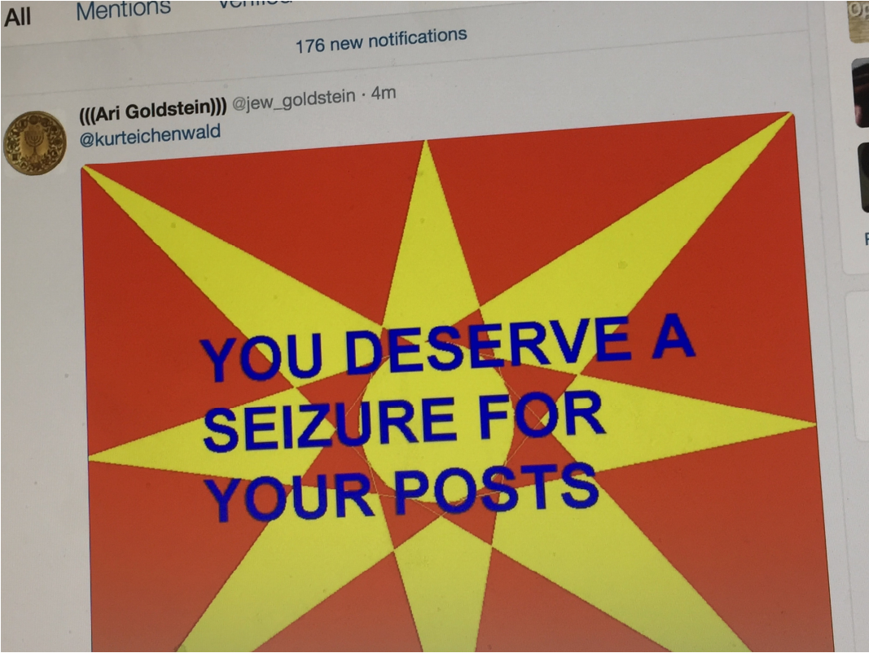

Slide 36
Outcome
There is a civil and criminal component to this. The civil suit was heard in Maryland (Rivello’s jurisdiction) - Eichenwald won, but only $100,000 including all fees and damages.
The criminal case is ongoing, but Rivello was set to plead guilty in 2019, but was stayed due to a suicide attempt. That is the last I know.

Slide 37
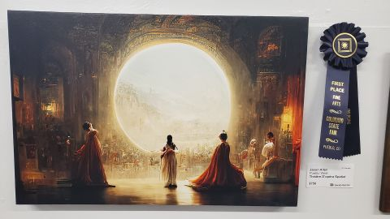
Notes:
n August, Jason M. Allen's piece "Théâtre D'opéra Spatial" — which he created with AI image generator Midjourney — won first place in the emerging artist division's "digital arts/digitally-manipulated photography" category at the Colorado State Fair Fine Arts Competition.
First, he said, he played around with phrasing that led Midjourney to generate images of women in frilly dresses and space helmets — he was trying to mash up Victorian-style costuming with space themes, he said. Over time, with many slight tweaks to his written prompt (such as to adjust lighting and color harmony), he created 900 iterations of what led to his final three images. He cleaned up those three images in Photoshop, such as by giving one of the female figures in his winning image a head with wavy, dark hair after Midjourney had rendered her headless. Then he ran the images through another software program called Gigapixel AI that can improve resolution and had the images printed on canvas at a local print shop.

Slide 38
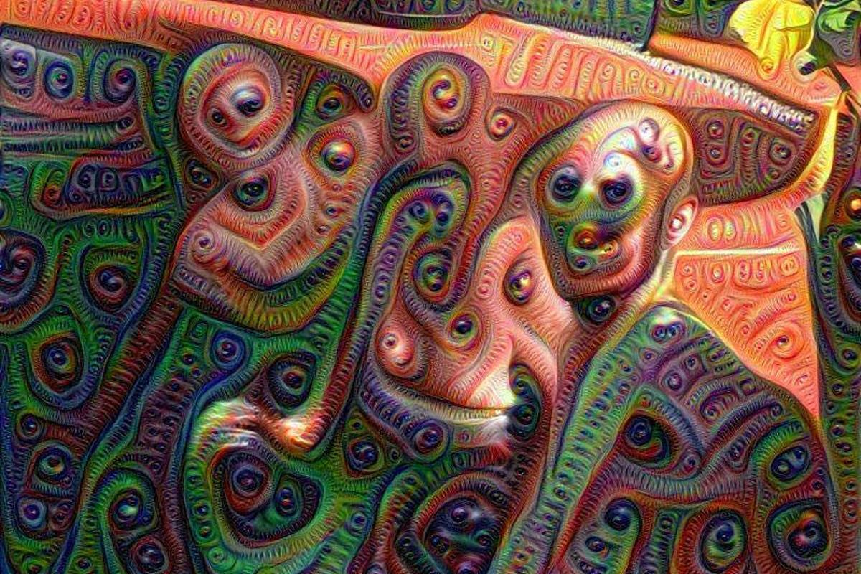

Slide 39

